Slide 1

ITC 6000 Database Management Systems Final Project Presentation 2021 Spring A YouTube
John DiSessa
Disessa.j@northeastern.edu

Slide 2
Overview
Project Overview
User Personas
SQLite Examples
Next Steps / Lessons Learned

Slide 3


Project Overview
My Project | Real-World
10 Videos | 500 hours uploaded per hour
20 Users & Creators | 30 million DAU
Single-Tier (SQLite) | Content Delivery Network (CDN)
Cost, Supportability, & Scalability | Security, Reliability, & Performance
Lagging Indicators | Leading Indicators

Slide 4
Personas
Users
View videos and ads
Free to use
Creators
Create and upload content to Channels
Earn money via ads (55/45 split)
Advertisers
Create ads to show Users
Pay YouTube per view

Slide 5

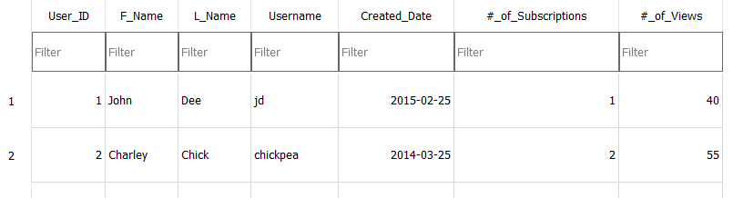

New User

Slide 6
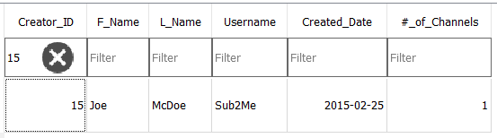
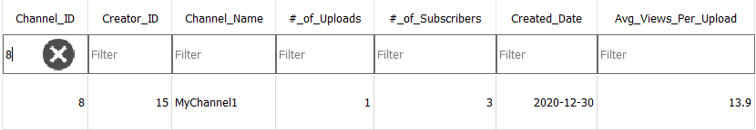
New Creator

Slide 7

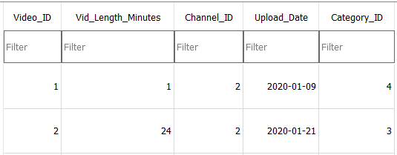
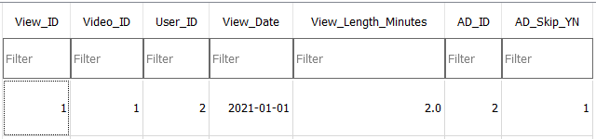
New Video

Slide 8
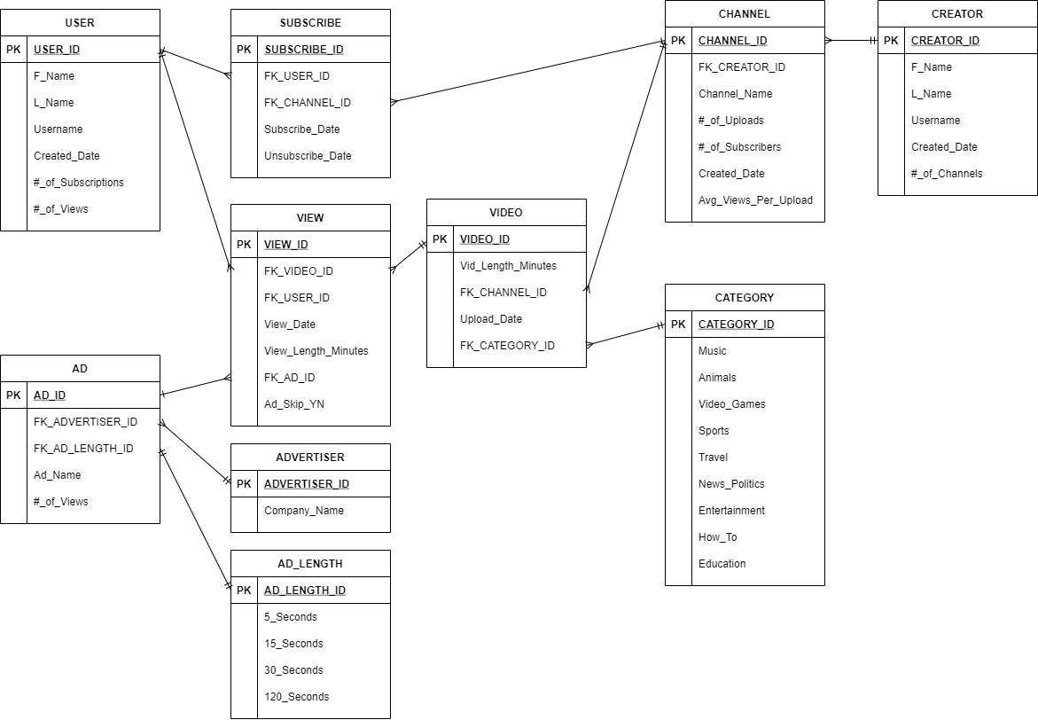
ER Diagram

Slide 9
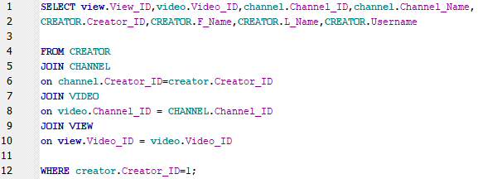
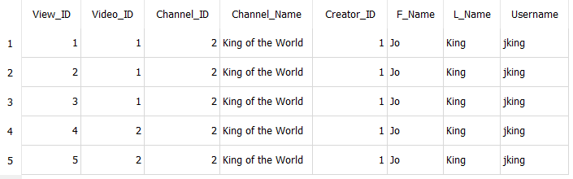
Query Example
Notes:
See total views to calculate revenue per creator

Slide 10

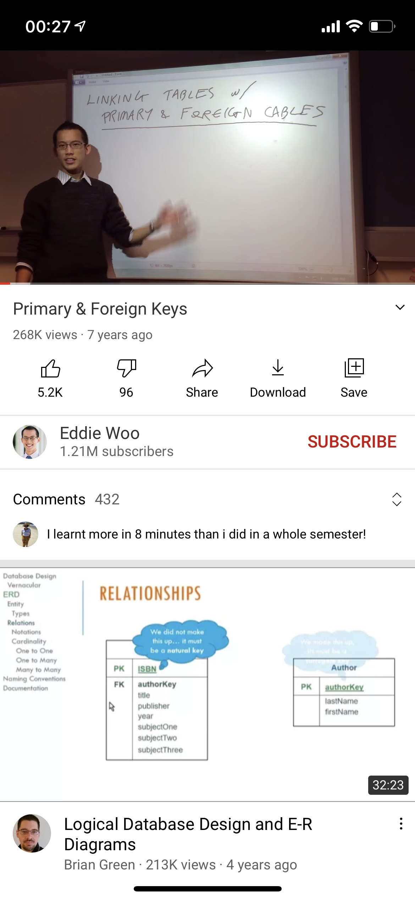
Data Table Representation
Video
View
Video
Channel
Subscribe

Slide 11
Next Steps / Lessons Learned
Value Added
Likes, comments, and ad flexibility
Live aggregates & KPI’s
Thank you
Questions

